Slide 1

#UUPathways
Communicating
Climate Change
Sandra van der Hel
PhD candidate and junior lecturer, Utrecht University

Slide 2
Tipping points and other metaphors for sustainability
Pathways to Sustainability Conference 2020: Accelerating the Transformation
Sandra van der Hel
Copernicus Institute of Sustainable Development, Utrecht University

Slide 3
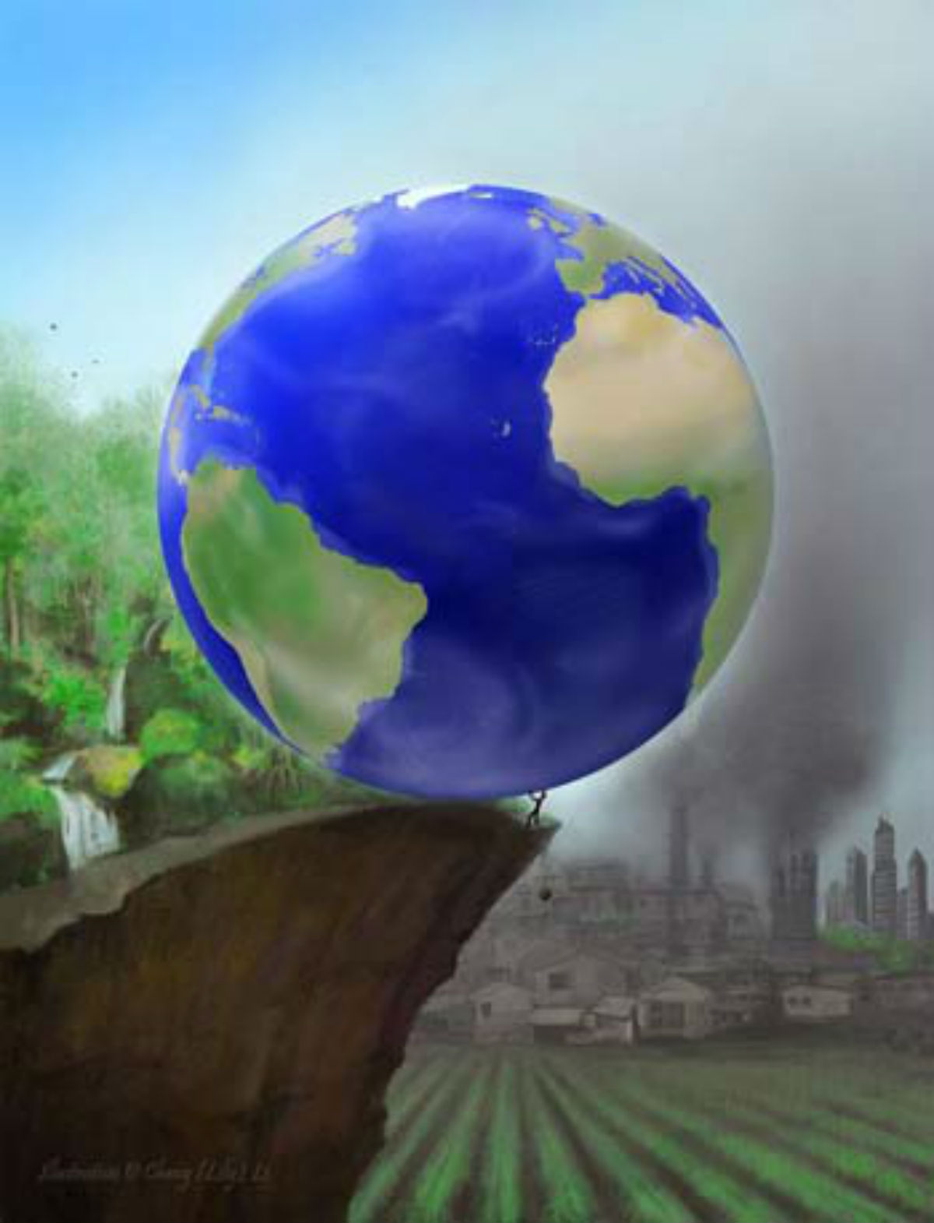
Illustration by Cheng 'Lily' Li

Slide 4
Based on van der Hel, Hellsten, Steen, 2018. Environmental Communication 12:5

Slide 5
Challenges
(too) alarming
Neglecting social differences
Limited action perspective

Slide 6


