Slide 1
Transition to Open Science
Towards a Realistic Image and Improved Practice of Science
Frank Miedema
Vice Rector Research, Utrecht University
Chair UU Open Science Program
Twitter @MiedemaF; www.scienceintransition.nl

Slide 2
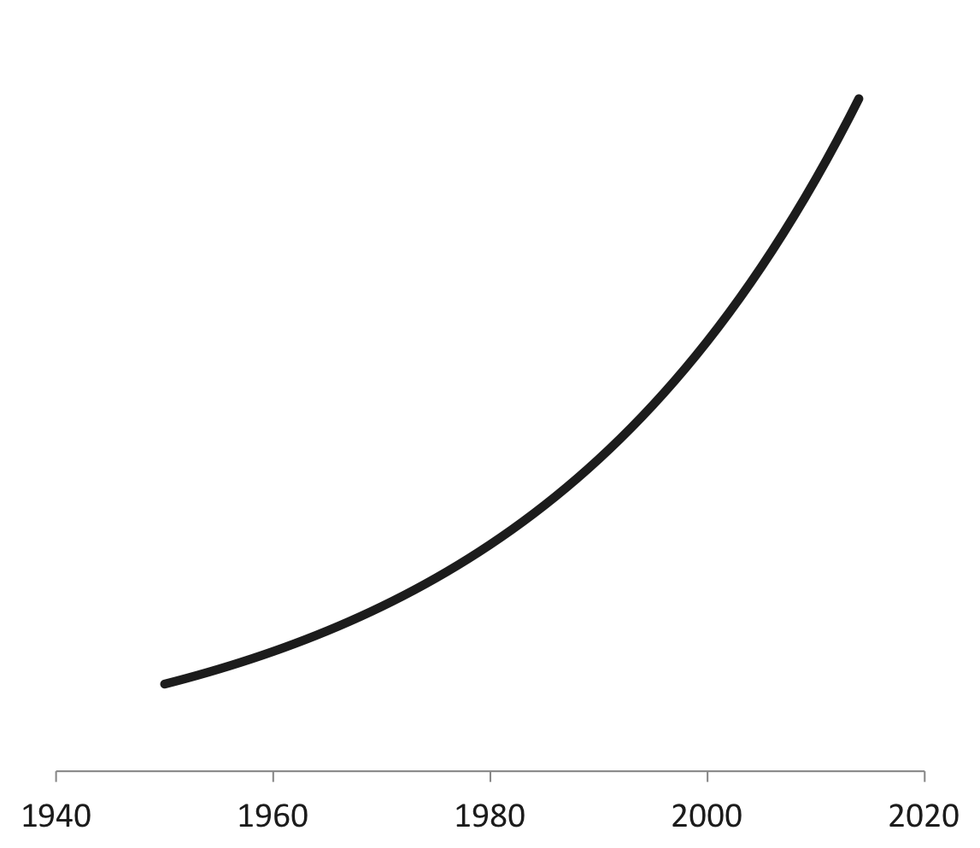
Today, annually ≈
>2.0 million scientific publications
3% annual growth

Slide 3
Biomedical Research suffers from major systemic flaws
Womens Health, CVD and Oncology: only about 25% of published preclinical studies could be validated to the point at which projects could continue
(Prinz et al, Nature Reviews Drug Discovery, 2011)
Amgen: of 53 landmark oncology papers in only 6 (11%) cases scientific findings were confirmed
(Begley and Ellis, Nature, 2012)

Slide 4
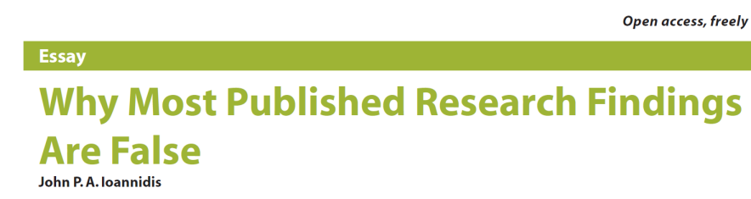

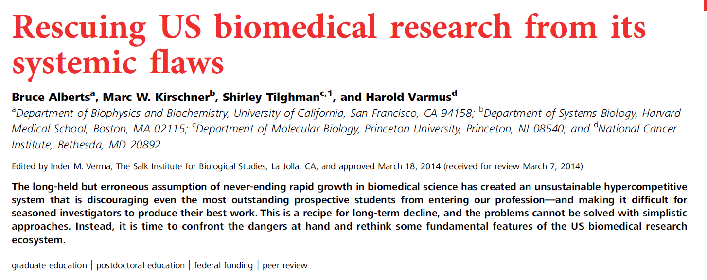
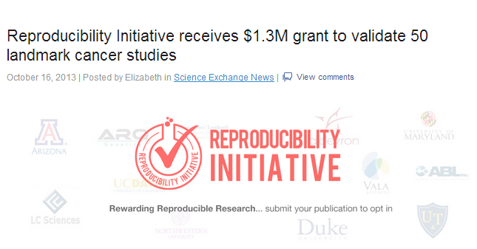
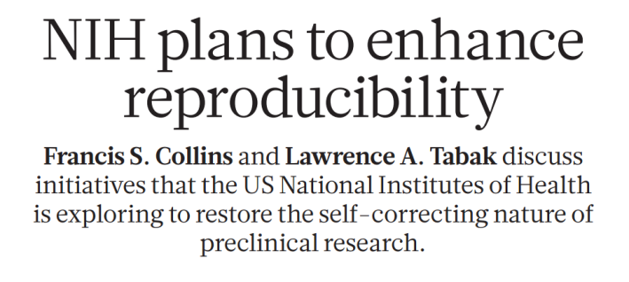
2006: 1,35 miljoen publicaties
Notes:
Why: Reward systems incentivise quantity more than quality, and novelty more than reliability.
Solution: publish less, but better and more relevant papers

Slide 5
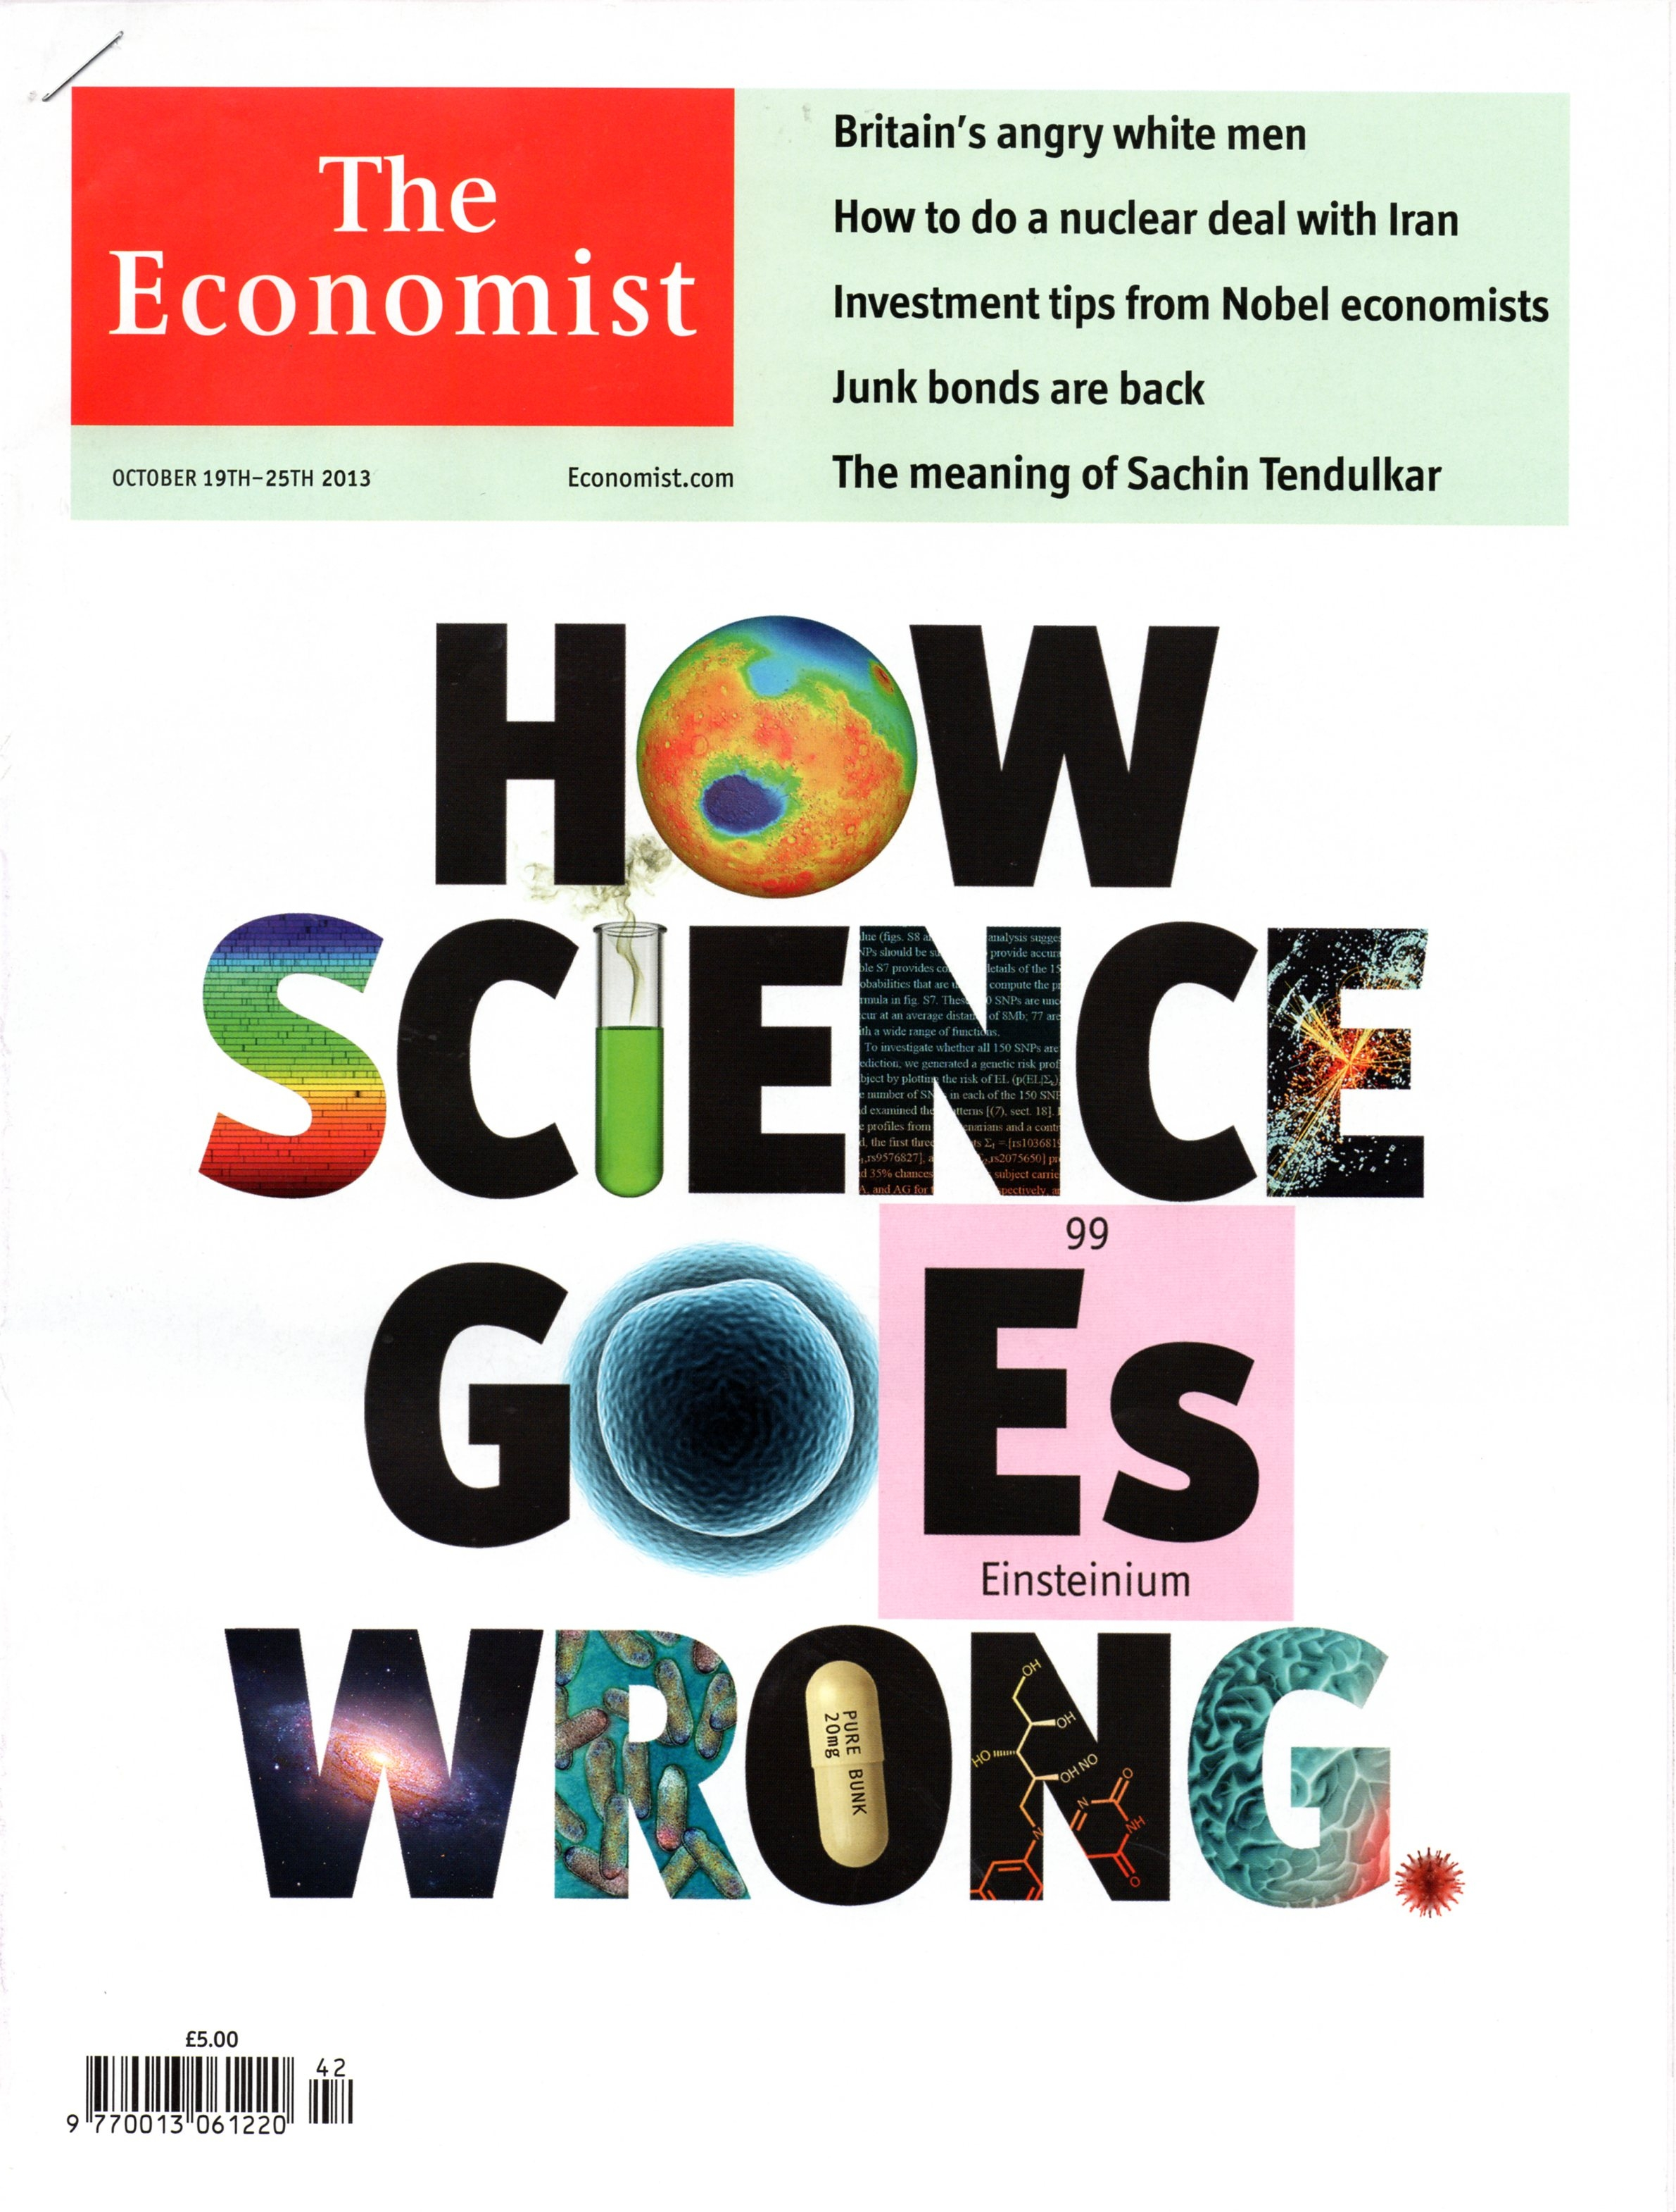
October 2013

Slide 6

Much biomedical research does not lead to worthwhile achievements. 85% of research investment—equating to $200 billion of the investment in 2010—is wasted
Significant problem with reliability, quality, reproducibility and because of publication bias.
Few identified biomarkers have been confirmed by subsequent research and few have entered routine clinical practice.
Lancet, January 2014, Ioannidis, Altman, Chalmers, Glaziou, Horton et al.

Slide 7
Just some of the problems of the science system
Replication crisis
Competitive and non-cooperative practices
Massification, competition, embargos, positivity bias → unproductivity
Monopolized and expensive publication markets
Privatization of infrastructures and problems of knowledge ownership / knowledge access
Non-recognition of importance of knowledge commons outside of specialist communities
Brain Drain and publish or perish...
Katja Mayer, Vienna

Slide 8
The Scientific Field: Professional Interests, Elites, Stratification, Power Struggle, and Economics
‘
Volkskrant
Pierre Bourdieu, Science of Science, 2004

Slide 9
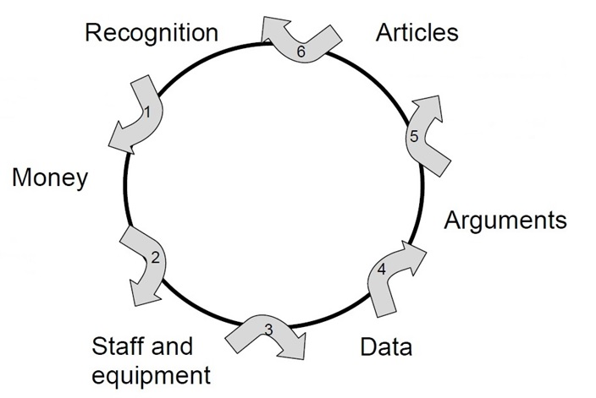
Problems of the Current Reward System in Science
Society is largely absent from the
credibility cycle
Quality in Quantitative terms: - number of articles, journal impact factor, citations, H-index
- amount of funding obtained
Hypercompetition for limited funds works against:
Team-Science, Multidisciplinarity & Diversity
Most papers still behind paywalls
Data not shared
Notes:
Background:
there are ever more scientists
Institutions translate societal call for accountability into targets/deliverables/output measures for individual researchers
Understandable response to rankings, internationalization, increase in number of scientists/hypercompetition for funding
Historisch nog wel relevant om te realiseren dat het denken in output wel een reactie is op politiek/maatschappij die sinds jaren 70/80 vraagt om concrete opbrengsten van wetenschappelijk onderzoek dat gedaan is met belastinggeld

Slide 10
Metrics Shapes Science 1
Quality, replication, relevance and impact are subordinate to novelty and quantity
Short-termism and risk aversion because of 4-year cycles
Universities outsource talent management to funders based on flawed metrics instead of having a research strategy going with their mission

Slide 11
Metrics Shapes Science 2
Fields with high societal impact, but low impact in the metrics system suffer (applied << basic; SSH << STEM)
The national and institutional research agenda is not properly reflecting societal (clinical) needs and disease burden
Open Science (responsible) research practices, stakeholder engagement, preregistration, FAIR DATA and Open Access are just ‘nice to have’

Slide 12
The ‘Legend’, dominant, but flawed image of science determines and distorts the practice of scientific inquiry.
1. This is reflected in the organization and the politics of academia (‘the credit cycle’)
2. This works through the still dominant criteria for excellence used in research evaluations throughout the ‘credit cycle’ by universities, funders & journals
scienceintransition.nl 2013, 2014

Slide 13
The standard/popular image of
Science and Research: the ‘Legend’*
‘Facts and values; science and non-science are neatly separated, which makes science objective and neutral’
‘This method explains the succces of the ‘hard’ sciences’
”the ‘soft’ social sciences and humanities are methodologically problematic’’
*Kitcher 1993; Ziman, 2000 Real Science; Miedema, Science 3.0, 2012

Slide 14
The ’Legend’ distorts the practice of scientific inquiry through flawed academic hierarchies
Natural and biomedical science >> Social science and humanities (‘physics envy’)
2. Theoretical & pure science >> applied science and technology
Curiosity-driven research is best for solving societal problems (the linear model)
Science should be autonomous, not be interfered by external publics or politics and their problems
Scientific knowledge is neutral; scientists are not responsible for the knowledge they (don’t) produce

Slide 15
Towards a realistic view of science
Inquiry is a social process producing reliable, that is ‘objective’ (intersubjective) knowledge
Science and the natural sciences have no, never had, a unique formal method to produce ‘truth’, that is a persistent myth
There are many ways (methodologies) to do good research
Hypotheses are tested in experiments, discussed, improved and accepted by the community, until a better alternative comes along that stands the tests of scientific rigor
Kitcher 2011; Longino 1999;Ziman 2000; scienceintransition.nl.
Notes:
Merton’s context: relation between power and scientist in dictatorships (Hitler, Stalin). Border between society and science demarcated.
Ziman’s context: Universities are like any corporations, and output directly economically measurable. Globalization
Etzkowitz: Triple Helix: Academy/Region/Industry

Slide 16
Open Science:
Open Production and Use of Knowledge
The overall aim of Open Science is to increase the quality, progress and scientific and societal impact of research and scholarship.
To achieve these goals in the practice of Open Science
Engage -when appropriate- with relevant and representative stakeholders from society to:
Define problems to be investigated; discuss ongoing research
Actively promote that the results of any kind provide guidance for implementation and action(s) in the specific contexts.
Notes:
Background:
there are ever more scientists
Institutions translate societal call for accountability into targets/deliverables/output measures for individual researchers
Understandable response to rankings, internationalization, increase in number of scientists/hypercompetition for funding
Historisch nog wel relevant om te realiseren dat het denken in output wel een reactie is op politiek/maatschappij die sinds jaren 70/80 vraagt om concrete opbrengsten van wetenschappelijk onderzoek dat gedaan is met belastinggeld

Slide 17
Open Science:
Open Production and Use of Knowledge
The overall aim of Open Science is to increase the quality, progress and scientific and societal impact of research and scholarship.
To achieve these goals in the practice of Open Science
Share research results, if possible, in several stages of the work and publishing these papers Open Access
And if possible Data and Code (Software) Open Access
Notes:
Background:
there are ever more scientists
Institutions translate societal call for accountability into targets/deliverables/output measures for individual researchers
Understandable response to rankings, internationalization, increase in number of scientists/hypercompetition for funding
Historisch nog wel relevant om te realiseren dat het denken in output wel een reactie is op politiek/maatschappij die sinds jaren 70/80 vraagt om concrete opbrengsten van wetenschappelijk onderzoek dat gedaan is met belastinggeld

Slide 18
Open Science Evaluation:
Incentives and Rewards
Pluriformity of quality indicators:
Not JIF, not H-index, nor numbers of publications
Engage Non-academic Stakeholders
Diversity and inclusiveness
Peer review, narratives, supported by data
Open Science practices and efforts rewarded
Notes:
Background:
there are ever more scientists
Institutions translate societal call for accountability into targets/deliverables/output measures for individual researchers
Understandable response to rankings, internationalization, increase in number of scientists/hypercompetition for funding
Historisch nog wel relevant om te realiseren dat het denken in output wel een reactie is op politiek/maatschappij die sinds jaren 70/80 vraagt om concrete opbrengsten van wetenschappelijk onderzoek dat gedaan is met belastinggeld

Slide 19
National Strategic Evaluation Protocol
The Netherlands 2021-2027
  The research unit:
Vision, strategy and aims of the research are outlined
Narratives (supported by data)*
Free choice of indicators
*Compatible with DORA
https://www.vsnu.nl/files/documenten/Domeinen/Onderzoek/SEP_2021-2027.pdf
Notes:
Background:
there are ever more scientists
Institutions translate societal call for accountability into targets/deliverables/output measures for individual researchers
Understandable response to rankings, internationalization, increase in number of scientists/hypercompetition for funding
Historisch nog wel relevant om te realiseren dat het denken in output wel een reactie is op politiek/maatschappij die sinds jaren 70/80 vraagt om concrete opbrengsten van wetenschappelijk onderzoek dat gedaan is met belastinggeld

Slide 20
National Strategic Evaluation Protocol
The Netherlands 2021-2027
Evaluation is in relation to the unit’s strategy
Three criteria:
Research Quality, Societal Impact and Viability
Four Aspects:
Open Science practices and efforts
PhD policy and Training
Academic Culture (Openess, Safety, Inclusiveness, Research Integrity)
Human Resources Policy (Diversity, Talent Management)
https://www.vsnu.nl/files/documenten/Domeinen/Onderzoek/SEP_2021-2027.pdf
Notes:
Background:
there are ever more scientists
Institutions translate societal call for accountability into targets/deliverables/output measures for individual researchers
Understandable response to rankings, internationalization, increase in number of scientists/hypercompetition for funding
Historisch nog wel relevant om te realiseren dat het denken in output wel een reactie is op politiek/maatschappij die sinds jaren 70/80 vraagt om concrete opbrengsten van wetenschappelijk onderzoek dat gedaan is met belastinggeld

Slide 21

UU Open Science Program 2018-2022
Incentives
&
Rewards
Open Access
Publications
Open Science
Programme
UU
Public Engagement
&
Outreach
FAIR Data
&
Open Code
https://www.uu.nl/en/research/open-science

Slide 22
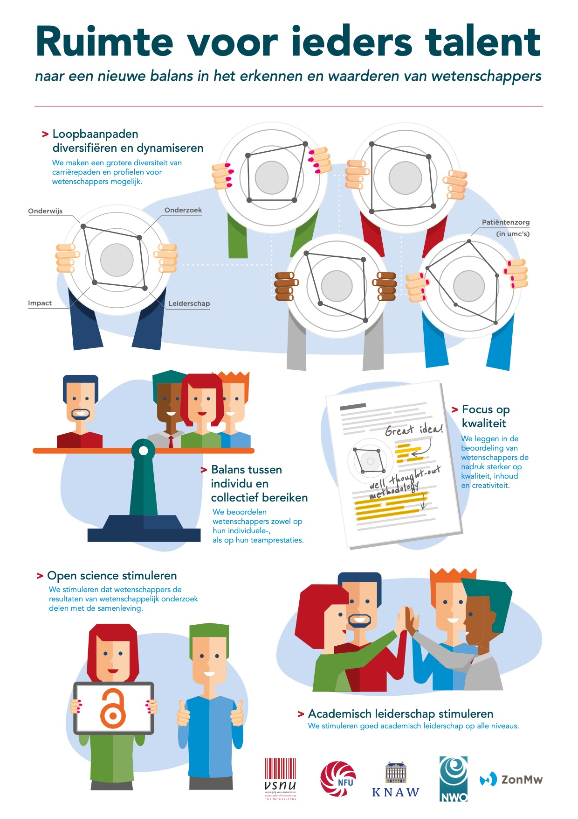
https://www.vsnu.nl/Erkennen-en-waarderen-van-wetenschappers.html

Slide 23
Open Science: To improve quality and integrity
at the personal level by systemic change
Engagement of societal stakeholders in problem choice
Inclusive indicators
Quality
Societal Impact
Use in and outside academia
Process Indicators
OPEN PEER REVIEW
POST PUB PEER REVIEW
OA publishing
FAIR data sharing
Notes:
Background:
there are ever more scientists
Institutions translate societal call for accountability into targets/deliverables/output measures for individual researchers
Understandable response to rankings, internationalization, increase in number of scientists/hypercompetition for funding
Historisch nog wel relevant om te realiseren dat het denken in output wel een reactie is op politiek/maatschappij die sinds jaren 70/80 vraagt om concrete opbrengsten van wetenschappelijk onderzoek dat gedaan is met belastinggeld

Slide 24
@UMCUTRECHT: Inclusive set of generic indicators for research quality and impact (in use since 2016)
Structure | Leadership & culture
 | Collaborations with stakeholders
 | Continuity and infrastructure
Process | Setting research priorities
 | Posing the right questions
 | Incorporation of next steps
 | Design, conduct, analysis
 | Regulation and management (OA, FAIR data sharing)
Outcomes | Research products for peers
 | Research products for societal groups
 | Use of research products by peers
 | Use of research products by societal groups
 | Marks of recognition from peers
 | Marks of recognition from societal groups
https://www.umcutrecht.nl/getattachment/Research/Science-in-Transition/
Format-Impact-indicator-evaluation-pilot-incl-introduction.pdf.aspx?lang=en-US

