Slide 1
Open Societies Big Tech & Legal Response
Anna Gerbrandy
Professor of Competition Law:
Contact at: A.Gerbrandy@uu.nl
Notes:
I am a laywer. So it is expected that I say something about the legal dimension of today’s debate on the challenges for the open society.
The first thing I tried to do is relate the dimensions of the Open Society that Marc Bovens presents in his paper to more specificity for the legal system:
It results in a picture like this:

Slide 2
Open societies & the law
Bovens’ identified perspectives & meaning for legal systems
Popperian | No absolute rules; rules based on scientific insights & intellectual reasoning
Liberal | Rule of law: protection of fundamental rights & individual liberties & checks & balances of power
Socio-cultural | Public sphere: freedom of press, speech, media-pluriformity
Socio-economic | Instituting markets, socio-economic rights & equalizers
Constitutional | Legal system: governance based on rule of law & democracy
Notes:
Marc identifies four or five (depending how you read) perspectives on what the concept of open society means. These dimensions relate to the legal system in different ways:
A popperian perspective means for the legal system that…. (etc)
…
As to the challenges, we have already heard about of few of them, and they are many… (next slide)

Slide 3
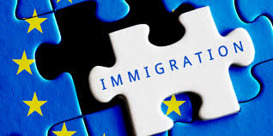
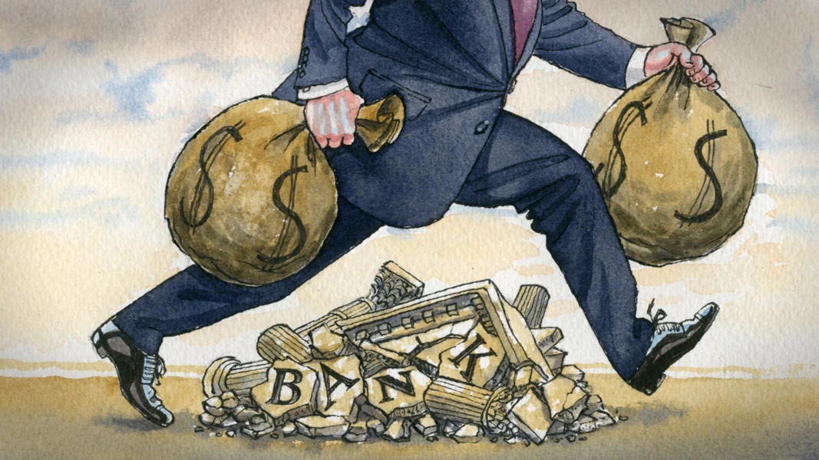
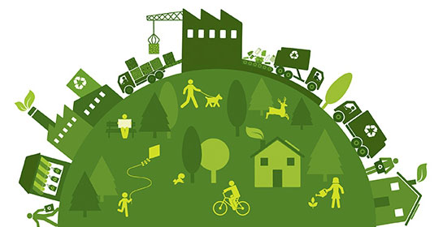
Big challenges & challenges for legal system
Law struggles to adapt/answer/react
Legal system/rule of law itself under threat
Notes:
There are, of course, several big challenges:
Global warming
Refugees & immigration
Digitalisation
Polarisation, inequality and populism
Sustainability
These are challenges for the legal system in at least two ways:
The legal system needs to adapt/answer/react (which cuts across all the dimensions of the open society )
The legal system itself might be under threat because of these challenges,
or in answering to these challenges, the legal system deviates from established principles of the rule of law
Now, the law is very vast, and I am familiar with only few of its dimensions.
So I have decided to present my story here as one slice of this bigger picture. That slice relates to Big Tech and the legal response to the challenges that it raises.

Slide 4
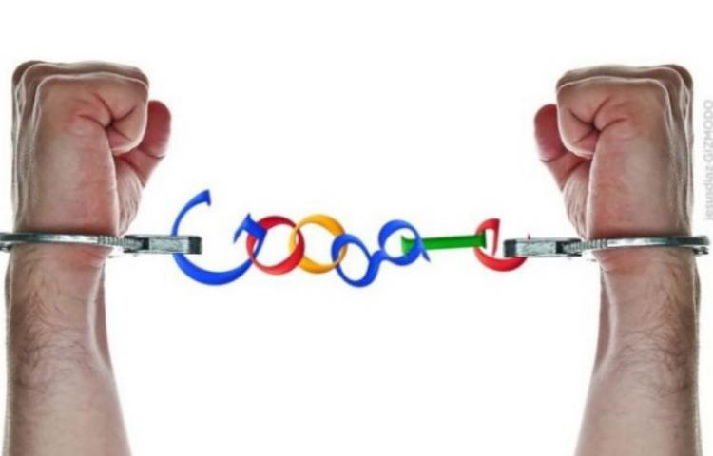
Notes:
Big Tech:
is generally understood as relating to four of five very big companies: facebook, google/alphabet, amazon, apple and Microsoft
But I would like not to overlook what is happening in Pharma and agrifood (such as Dow Dupont) where companies are becoming more and more technology-based and offer business models based on platformisation
The question that I have been asking for a while now is wehterh these big companies are a new incarnatin of the same thing – market power, dominance in competition law terms, deep pockets, being able to leverage market power from one market to another, excluding rivals from entering the market, lobbying power etc – or something new. A century ago, or so, this was labelled – esp. in the USA – with the term ‘Bigness’
But I think they are something new. Which I have labelled with ‘Modern Bigness’:
Of course these companies have market power
-> and in an open society market power can be a threat (in the socio-cultural domain, but also in the constitutional domain).
But we have laws to counteract the negative effects of market power. One of which is COMPETITION LAW (which is my field of law) .
For today’s discussion it is interesting however, to note that the power of Big Tech is much more than market power:

Slide 5
Modern bigness
Market shares
Size
Data
Gate-keeping
News
Policies
Re-arrange labour
Notes:
Which I have tried to capture in this picture
They have high market shares and are very big, but:
They collect masses of data, which they have the capacity to analyse to depths
They have a gatekeeping function into an ecosystem of platforms – I am using Jose’s terminology here
This is especially true for access, and shaping of news
They impact policy making
And rearrange existing socio-economic strucutres, such as labour relations
(and ther is probably more)
This means that Big Tech is a challenge for the open society from many perspectives
So what is the legal response?

Slide 6
Modern bigness
market
non-market
entangled effects
Notes:
Well, it is mixed.
And to understand why, this is an important slide:
The effects of Modern bigness are felt not just in the market sphere – where competition law can deal with it (though we might question the effectivenss here), but also in the non-market sphere
(or, if you like: the market domain and the public domain)
Importantly, these effects stem from the same source (same power, same dataflows).
Both the source is shared and the effects become entangled, but
Current competition law cannot really deal with non-market effects. It does not have the instruments, or even when it does, it is not poised to use them here, at least not in the EU.
My hypothesis is that this is untenable, but that is part of what I will be researching in the coming years.
For today I have tried to map, along the dimensions of the Open Society concept, where Big Tech raises challenges

Slide 7
Open societies, the law & challenges of Big Tech
Bovens’ identified perspectives |  | Challenge of Big Tech
Popperian | No absolute rules; rules based on scientific insights & intellectual reasoning | Digitalisation positive and negative?
Liberal | Rule of law: protection of fundamental rights & individual liberties & checks & balances of power | No legal response to power of Modern Bigness, no accountability for Big Tech, privacy, equal treatment problematic, no checks & balances
Socio-cultural | Public sphere: freedom of press, speech, media-pluriformity | How to shape legal response to impact on media-pluriformity and public sphere
Socio-economic | Instituting markets, socio-economic rights & equalizers | Adaptation to new forms of market-effects under way; but how to respond to platformisation of labour and effects on inequality
Constitutional | Legal system: governance based on rule of law & democracy | How to counter influence on elections; capture & lobbying
Notes:
The challenges of Big Tech cuts through all the dimensions of the open society:
Lets skip the popper one for now
Liberal perspective shows the start of our problems:

Slide 8
Big challenges & challenges for legal system
Law struggles to adapt/answer/react
Legal system/rule of law itself under threat
Notes:
This means, in sum, that there is a struggle to respond.
The reasons are many:
Because the power of Big Tech goes beyond markets, while the legal system that counters power - competition law – is geared up to focus mainly on the market
That means there are different legal rules for each of these elements (e.g. privacy rules), but these do not focus on power as such, which I think is the overarching threat to the open society
An additional difficulty is that Big Tech companies seem to push over into public domain/public service/nutsvoorzieningen
Even more: big tech spills into warfare, into food, into health
And:
Also because the developments have gone very quickly, and the law is always and necessarily so, slow to respond
But…

Slide 9
Big challenges & challenges for legal system
Law struggles to adapt/answer/react
Legal system/rule of law itself under threat
Notes:
But the LEGAL SYSTEM is also itself under threat, I think, perhaps, in three ways:
One is the influence of big tech companies on the shaping of the law -> but there is a backlash now,
In shaping that backlash regulators/governments might go beyond the constitutional principles of having a legal basis to act
In some countries, of course, technology is used in a way that is a direct counteracting of the notion of an open society

Slide 10
Big challenges & challenges for legal system
Law struggles to adapt/answer/react
Legal system/rule of law itself under threat
Notes:
I think this story, with many variations, can be told with regard to other global challenges.
The same questions can be asked across this board:
How can the legal system respond so as to counter the threats to open societies
How can societies respond to threats to the legal system, based on the rule of law, itself.
I am not pessimistic though: in relation to Big Tech we seem to see the start of a system change. Both the legal system and society seem to counteract the impact. And though this is not often explained in language which uses the term ‘ open society’, concerns for protection of that open society seem to lie at the basis of this response.
The trick for the legal system is to be both responsive and resilient and be fully aware of its key position in safeguarding the existence of an open society.

Slide 11
