Slide 1
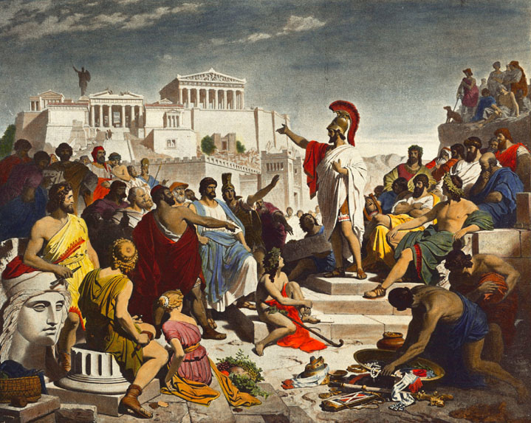
Should political micro-targeting be a competition law concern?
VIKTORIJA MOROZOVAITE
ANNA GERBRANDY

Slide 2
RQ: Should political microtargeting be a competition law concern?
The processes that drive the digital market and the development of the “platform society” are led by giant tech companies that lie at the center of the digital economy and its infrastructure. They are driven by market logic with effects of their composite power spilling into economic, social and public spheres.
Our thought experiment: how should a legal field concerned with negative effects of market power deal with these deeply entangled effects (market, social, public)?
The “why” of the paper
Key takeaways:
Conclusion
Due to the composite power of big tech companies and the dual role of user (consumer and citizen concomitantly), the manifestations of market power may pose a threat to citizen values. By treating citizens as consumers, big technology companies in effect reduce incommensurable democratic values to fit economic metrics.
ECL is triggered when a dominant company abuses its market position to the detriment of consumers. Microtargeting processes involve multiple actors, however, big tech companies serve as both the source (data) and the means (Ad Tech Stack, advertising tools, role of algorithms). Currently, ECL’s “consumer welfare” enforcement standard is too narrow to address democratic concerns and may need to be expanded to fit digital market realities.

Slide 3
European competition law aims to curb the negative effects of market power
European Competition Law (ECL) is a legal regime most closely concerned with curbing the negative effects of market power (prohibition against abuse of dominant position is one of its strands – Art.102 TFEU).
“Dominance” is a narrowly construed concept and as such is not prohibited. Instead, ECL protects against abusive manifestations of market power that leads to exclusionary, exploitative or discriminatory conduct to the detriment of consumers.
The modernization process resulted into the apparent narrowing of the goals of competition law to (mostly) consumer welfare and giving prominence to neo-classical economics methods of analysis.

Slide 4
The goals of ECL are not clearly defined
The goals of ECL are not clearly defined. The European Commission embraces the “consumer welfare” standard, while the Court, it seems, has not let go of the more pluralist notion of goals.
ECL and Ordoliberalism roots: interactions and balancing of private (economic) and public (state) power. Excessive power is perceived as a threat to the functioning of markets, limit economic freedom of market actors and lead to unfair societal outcomes.
“Freedom” in an economically active society is both the source and the existence of all individual values.
Here, economic freedom is an ordered freedom that takes place within the framework of the State’s authority.

Slide 5
Democratic values are at stake
User-citizen
User-consumer
Personal autonomy (2 elements):
De facto power to govern oneself
Authoritative control of one’s own choices, goals, actions
Equality
Structural
Discursive
Consumer welfare:
Low prices, high quality, variety of choices and innovation
These parameters are generally understood to be measurable and quantifiable
Deliberative democracy and Habermasian public sphere ideas

Slide 6
Users concomitantly fulfil multiple roles in online environments
Consumer
Producer
Consuming digitally offered services, often free of charge, in exchange of exposure to ads
User
Amalgamation of roles and values
Distributor
Citizen
Friend
Receive and interact with the information that may play a role in shaping their political preferences
Notes:
Start of the “real issues”
Dual role of the user: consumer and citizen
Omit composite power

Slide 7
Psychological techniques used in PM are increasingly more sophisticated
Political Microtargeting (PM) refers to “the use of different communications to communicate and build relationship with prospective voters” (Bodo, Helberger and De Vries, 2017)
Development followed commercial advertising suit
Use of sophisticated psychological and technological techniques to deliver PM such as psychometric profiling e.g. Cambridge Analytica
Resemble the process of hypernudging, with an aim to target: the right user, with the right message, by the right means, as many times as needed.
The research on the effectiveness of PM is inconclusive

Slide 8
PM is delivered by multiple market actors within the data value chain
Data value chain
Data acquisition
Data analysis
Data application
1
2
3
Market actors
Data brokers
Internet platforms
Political data consultants
Voter registration records
Polls
Surveys
Other
A-B testing
Campaign apps
Third party tracking: cookies, beacons, fingerprints
Social media listening
Geotargeting
Search result influence
Addressable TV
Robocalls and mobile texting
Psychometric profiling
Source: Tactical Tech, “Personal data: political persuasion” (March 2019)
Notes:
Anna: the slide is not self-explanatory as stand-alone

Slide 9
Big tech is powerful regarding access to data and advertising infrastructure
Accessibility to data
Advertising tools and infrastructure (Ad tech stack)
Hold substantive and durable market position within each layer of digital advertising value chain
Tools allow to reach their users and gain insights (e.g. Facebook lookalike audience)
Sophisticated algorithms that follow economic imperatives
Notes:
Anna: change title to something: big tech companies are pretty dominant here

Slide 10
PM negatively affects citizen values
Personal autonomy
Equality
Consumer welfare
De facto power to govern oneself
Authoritative control of one’s own choices, goals, actions
Structural
Discursive
Low prices, high quality, variety of choices and innovation
These parameters are generally understood to be measurable and quantifiable.
Elements
Behavioral modification strategies that affect sub-conscious mostly violate both elements
Exclusion of some from political debate
Distortion in the public discourse
Inclusion of less accessible voters
Focus on issues that individuals care about most
Helps to deal with the “choice overload”
Intent behind relevance matters
Misalignment of incentives with the user may lead to reduction of choice and quality
PM effects

Slide 11
European competition law’s response is nuanced
Dominance?
Big tech companies hold substantive and durable market positions in advertising markets – they are the inevitable business partners and gateways of information
Consumer welfare approach is too narrow and unfit to deal with political microtargeting threats to democratic values
The amalgamation of user-consumer and user-citizen roles and the amalgamation of impacted values create an amplified need for prioritizing and rebalancing.
Political character of competition law
Should consumer welfare be expanded? “Citizen welfare” (van Dijck, 2019), “wellbeing of citizens” (Townley, 2009)
Other regulatory avenues?
European Democracy Action Plan, Digital Services Act, Digital Markets Act and other
Notes:
The narrative: we cannot deal with pm if we stick to consumer welfare. That there are reasons to reconsider that, and that if we use citizen welfare or wellbeing of citizens. PM, in some heinous and big-effect, behind-the-scenes so the user does not know what is happening, cases should be prohibited. As long as there is no other instrument, then probably competition law should step in. None of the regulatory stuff that is on the table now really targets pm, so competition law has a role. Do you agree with that conclusion?

Slide 12
Thank you!
Reach us:
v.Morozovaite@uu.nl
a.Gerbrandy@uu.nl
@Viktorija_mor
@Annagerbrandy

