Slide 1
Access to platforms via Essential Facilities doctrine and/or Public Utilities theory
Ius commune
Laura Frederika Lalikova
Ph.D Candidate in Competition Law
Notes:
(Put on the slideshow mode to view animations.)

Slide 2
Umbrella ERC funded project: Modern Bigness
Power of Big Tech
Negative effects on market and non-market values
Notes:
The project is part of an umbrella ERC-funded project on Modern Bigness which looks into the power that large tech companies possess and the types of negative effects this power may have on market and non-market values.
And whether it is competition law or other tools that can reduce or diminish these negative effects.

Slide 3
Research Question
Should access
To digital platforms
Be guaranteed by
and/or
Essential facilities doctrine
Public utilities theory
Notes:
To start off, the research question is the following:

Slide 4
WHY?
Notes:
Why?
Why this questions? Why these two options? I will attempt to summarise the thought process behind this question as clearly as I can within the time limit I have.

Slide 5
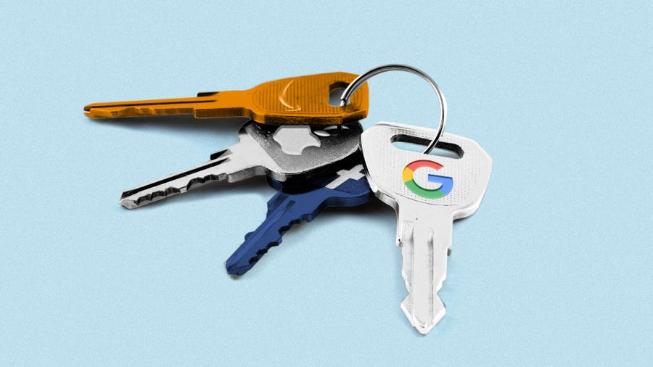
Why should access to digital platforms be guaranteed?
Consumer
Market actors
User-citizens
Gatekeepers
Platform society
Notes:
One can argue that many of the Big Tech platforms act as gatekeepers to their networks.
They are in possession of ‘digital bridges, digital network grids, digital railways’.
Access to these networks is necessary to reach the consumer.
Access to meaningfully participate in the ‘platform society’.
What if the access is denied totally or is contingent on arbitrary or discriminatory terms.

Slide 6
Why should access to digital platforms be guaranteed?
Market Value
Competition
User-consumer welfare
Non-Market Value
Notes:
Problematic from two levels in particular – market value, and non-market values.
For market value one would think of a healthy, level playing field competition.

Slide 7
Why should access to digital platforms be guaranteed?
Market Value
Competition
User-consumer welfare
Democratic participation in society
Accountability?
Non-Market Value
User-citizen welfare
Internal policies
Govern information flow
Interest in profit
Notes:
For the non-market value…new platform society.
They are backbones of social activities and interactions today.
Citizens should not be left at the goodwill of private companies to meaningfully and democratically participate in the new society.

Slide 8
Platforms as infrastructures
Notes:
We can hypothesize that we should perhaps be treat them as quasi-infrastructures. If we can prove that these platforms do in fact possess infrastructural characteristic…

Slide 9
Compatibility of Current Legal Tools To Access (Digital) Infrastructures
Essential Facilities Doctrine
(Competition Law)
Can we access? What could be accessed?
Public Utilities
Theory
(Regulatory Intervention)
Safeguard market and non-market values
User-consumer and user-citizen welfare
Notes:
Then we are brought to the analysis of the compatibility BETWEEN the current legal tools that govern access to traditional infrastructures VS these new digital infrastructures.
whether EFD or PUT can be used to guarantee access to the digital platforms – to these new digital infrastructures.
whether we should use one or both of these tools to safeguard market and non-market values sufficiently.

Slide 10
THANK YOU!
Laura F. Lalikova
Ph.D Candidate in Competition Law

