Slide 1
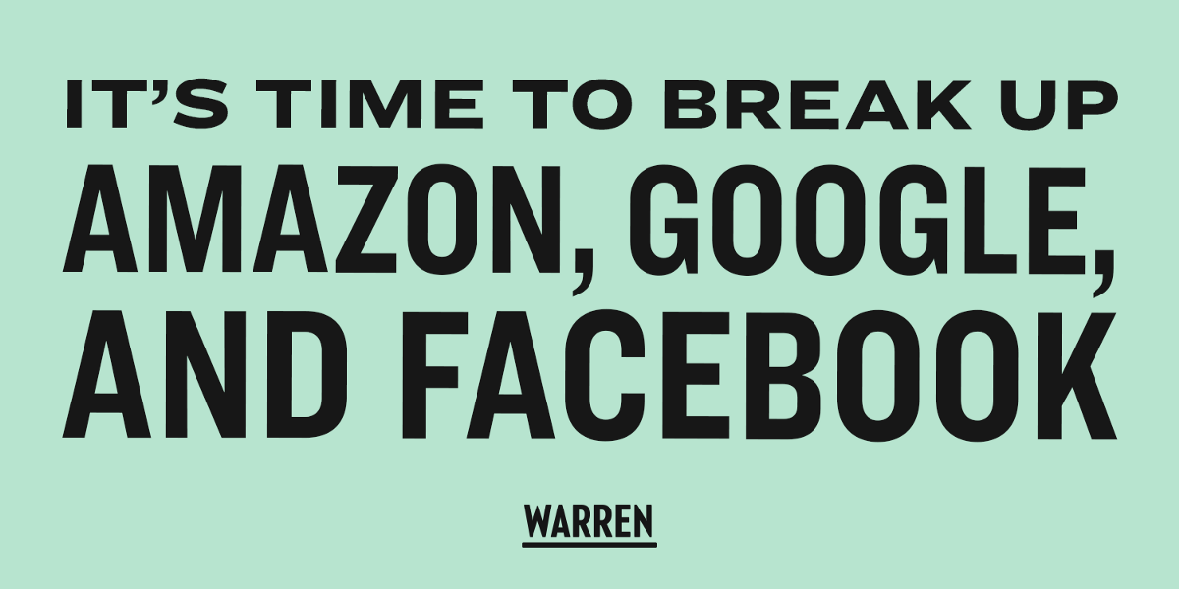
Notes:
“It’s time to break up Big Tech” – a quote maybe not too often heard in Europe but in the United States it was one of key points in the campaign of Elizabeth Warren, a contender for the Democratic nomination for President of the US. So why does she want to break up Big Tech?

Slide 2
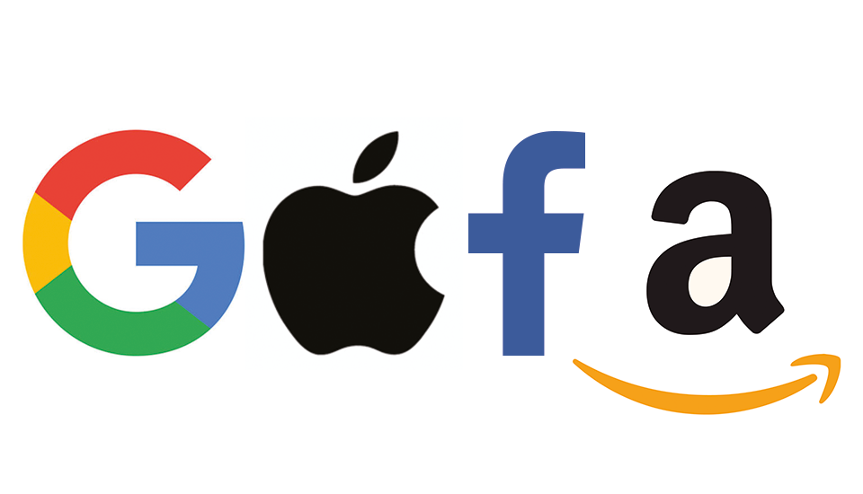
Notes:
These companies – Google, Apple, Facebook and Amazon – have been strongly influencing our lives. As our lives and businesses move online, these companies provide the underlying infrastructure for the exchange of communications, information, goods and services. Just think of how many times today you have accessed one of their services: maybe you used Google’s search engine or email service (Gmail) or Apple’s browser (Safari) or phone (iPhone). Even without noticing, they provide services to you. When using Netflix or Uber, you are actually accessing Amazon Web Services, which is the infrastructure that these businesses are build on. This all sounds great, so what is the problem?

Slide 3
Notes:
Since the 20th century the idea in economics and law has been that competition is the best way for our markets to function. When many firms are present on a market, competing for the money and attention of consumers, we get the best results in price, quality, variety and innovation. European competition law therefore has the goal to promote competition and maximize consumer welfare.
With these big companies present on our markets, economists and legal scholars are afraid that competition might be in danger and as a result, prices might rise, quality might worsen, variety might disappear, and innovation might slow down. Therefore, several proposals have been submitted to strengthen competition law and break up these big companies.

Slide 4
Modern Bigness-project
Hypothesis:
“Big Tech is a new power, called Modern Bigness”
The question is:
“How should European competition law respond to this new power?”
Notes:
My research project is part of the Modern Bigness-project. In the Modern Bigness-project the hypothesis is that Big Tech is a new power, that we call Modern Bigness. In the Modern Bigness-project 3 PhD-ers and 1 post-doc research the overall question: How should European competition law respond to this new power?

Slide 5
Gate-keeping
Data
News
Size
Policies
Modern bigness
Market shares
Re-arrange labour
Notes:
So what is this new power supposed to be? Traditionally in competition law, the competition agencies only examine market power, based on economic strength and measures market power by market shares and other competitive constraints. However, these new tech companies also have powers. For example, gatekeeping: deciding who can and who cannot access and use their platforms. In the Modern Bigness-project, the nature of this power is researched.

Slide 6
Research project
Before European competition authorities can intervene, it should be determined whether there is a dominant position in a defined market.
Actual competition
Potential competition
“Competition is just one-click-away”
“Big Tech is just waiting to be disrupted by innovation”
What is the effect of innovation on the dominant position of Modern Bigness?
Notes:
In my PhD-project, I research one specific aspect of this question.
In European competition law, before competition authorities can intervene, it needs to be established that a company has a dominant position on a defined market. For example, Shell has a dominant position in the market of selling gas or oil (but it might not have a dominant position in the green energy market). Or, Albert Heijn in the grocery market in the Netherlands (but not on the market of retail services). These dominant positions are defined by actual competition and potential competition. The actual competition is examined by defining a relevant market and then defining the market share of the company under investigation. Potential competition is – for example - examined by looking at how easy it is to enter the market for new companies.
For Big Tech, the aspect of potential competition is essential. When under investigation by competition authorities, Big Tech always excuse themselves by saying that the next innovation is looming to disrupt them, or “competition is just one click away.” Because of this constant threat of new innovations, they do not have a dominant position and competition law should not intervene. To establish whether Big Tech has a dominant position, I will examine whether these claims are true. Is there innovation just looming to disrupt them? And if so, does this mean that sufficient competition is present in the market and competition law should not intervene?

Slide 7
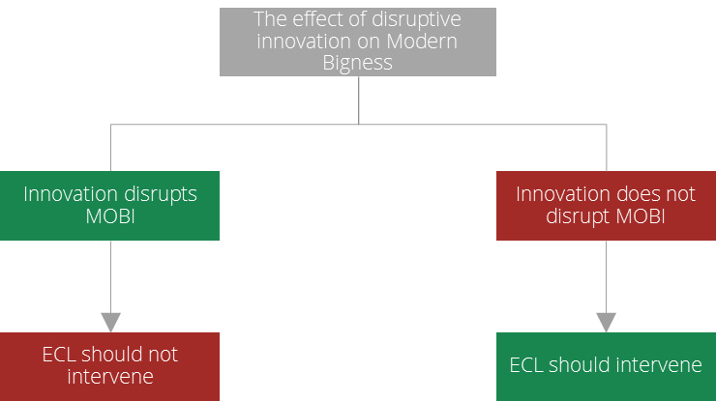
Research project
Current state of the law
No disruption: European competition law should intervene
Disruption: European competition law should not intervene
Notes:
Simply put, two outcomes are possible: innovation disrupts Modern Bigness or innovation does not disrupt Modern Bigness. If Modern Bigness is disrupted by innovation (with some other conditions), there is no dominant position. If Modern Bigness is not disrupted by innovation, there is a dominant position. Only once a dominant position is established, competition authorities can intervene. This is the current state of the law.

Slide 8
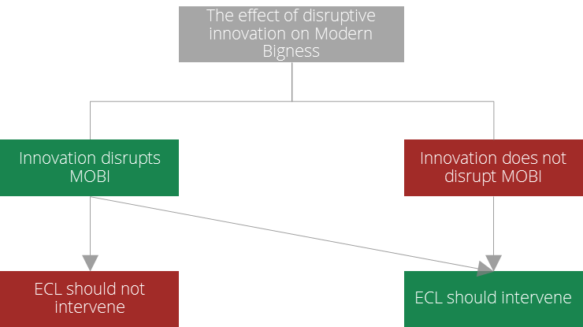
Research project
Future state of the law?
Maybe European competition law should intervene even if innovation does disrupt Modern Bigness?
Research question:
Is the current concept of dominance in European competition law still fit for purpose when applied to Modern Bigness, considering the effect of disruptive innovation?
Notes:
However, I will go further in my research and consider a third possibility. Even if I find that innovation disrupts Modern Bigness, should European competition law then intervene?
Which basically asks the question: is the current concept of dominance in European competition law still fit for purpose when applied to Modern Bigness?
It is important to not that this purpose is not only to achieve the goals of European competition law, such as maximizing consumer welfare, but maybe also the broader goals of European law, such as freedom. If the concept is no longer fit for purpose, the gateway to all the remedies (such as breaking up Big Tech) will not be efficient. That is what my research will examine in the coming years. And hopefully, I will be able to establish whether the gateway to remedies – the concept of dominance – is still open for Big Tech.

