Slide 1
Natural Resources Luncheon Talk University of Oslo
The interplay between EU law and Regional Sea Conventions:
marine environmental protection in relation to offshore energy production across Europe
Nikolaos Giannopoulos
n.giannopoulos@uu.nl
26 June 2020

Slide 2
Outline of the presentation
Introduction: normative interactions and the regulation of offshore energy production
Brief overview of the selected regional sea conventions
EU law and the environmental regulation of offshore energy production
Interactions between EU secondary rules and Regional Sea Conventions
The “Europeanization” of Regional Sea Conventions and its normative effects
Conclusions: the ensuing regional legal framework

Slide 3
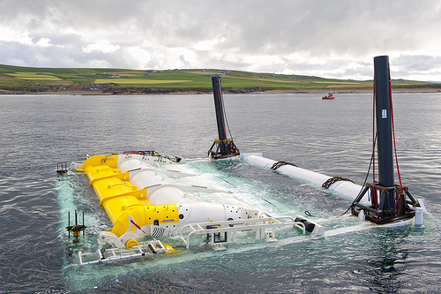
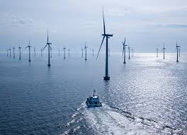
Introduction: normative interactions and the international regulation of offshore energy production
Why and which normative interactions?
Why offshore energy production?
Why focus on regionalism?
Why the selected regions?

Slide 4
European regional seas – EU law as an extra layer of regulation

Slide 5
The cross-fertilization of EU law and Regional Sea Conventions
Main argument: interactions between EU law and regional sea conventions are mutually beneficial
Enhance marine environmental protection with regard to offshore energy production across Europe, in terms of:
a/ substantive and procedural environmental rules
b/ enforcement – compliance with these rules

Slide 6
Brief overview of the selected regional sea conventions
Offshore Protocol to the Barcelona Convention – Mediterranean Sea
Annex VI on Prevention of Pollution from Offshore Activities to Helsinki Convention – Baltic Sea
Annex III on prevention of offshore pollution to OSPAR Convention – North-East Atlantic
Agreement on Cooperation on Marine Oil Pollution, Preparedness and Response – Arctic Ocean
Specialised rules on: precautionary principle & ecosystem-based approach
EIAs/SEAs
Operational / Accidental oil pollution
Use of BAT and BEP
institutional framework producing “secondary” instruments
What about marine renewables?

Slide 7
EU law and the environmental regulation of offshore energy production
Shared EU competence: environment (192 TFEU)
energy (194 TFEU)
The example of the Offshore Safety directive (2013/30/EU)
From a prescriptive EU regulation
goal-based directive
194(2): “Such measures shall not affect a Member State's right to determine the conditions for exploiting its energy resources, its choice between different energy sources and the general structure of its energy supply, without prejudice to Article 192(2)(c)”

Slide 8
Gradual specialization of EU environmental rules on offshore energy
General EU environmental directives
Integrated Maritime Policy
Offshore Safety directive

Slide 9
General environmental directives
EIA / SEA directives
Waste Framework directive
Birds and Habitats (Natura) directives
Hydrocarbon Licensing directive

Slide 10
Marine Strategy Framework directive (2008/56/EC)
Objective: good environmental status of the seas by 2020
goal-based approach
no substantive obligations
BUT checks and balances: -procedural obligatons
-monitoring and periodic assessment
-factors / ecological descriptors to guide States
regional cooperation
MSFD
Regional Sea Conventions
interactions

Slide 11
Offshore Safety directive (in relation to Regional Sea Conventions)
Reaction to Deepwater Horizon Accident
Narrower scope and goals than Regional Sea Conventions
- only major accidents
- minimum harmonization of environmental rules and standards
level playing field – internal market
Due diligence duty coupled with procedural obligations
- cooperation with other EU MS and third States
- notification
- emergency response plans
Weak prescription of the precautionary principle
No mention to EIA/SEA (but enhanced public participation)
Lack of a specialized EU monitoring agency - no independent role for the EMSA

Slide 12
The co-regulatory approach of the Offshore Safety directive
Co-regulation can combine benefits of public and private regulation
EU directive: meta-regulation – sets principles and delegates implementation
MS: regulatory intermediaires -> control through licenses, oversight of performance
Exceptional role for the private industry – self regulation
Technology neutral rules which allow for:
- development of private operational standards
- independent verification process of the standards
Autonomous procedural obligations: responsiblity of the industry
Need to comply with BAT and BEP (see EU BAT list)
involvement in the EU Offshore Oil and Gas Authorities Group

Slide 13
The scarcity of EU environmental rules for marine renewables
Environmental externalities of marine renewables largely unregulated at the EU level
Article 194(1)(c) TFEU: Union policy must promote renewable forms of energy
Renewable energy directive (2009 and its recast, 2018): RE mandatory targets
Marine renewables can play a key role (EU Green Deal, EU Biodiversity Strategy 2030)
BUT
EU has adopted a “wait and see” approach (and non-binding guidelines) - Paradox?
EU is preoccupied with economic considerations
- removing barriers in the internal market
- attracting investments with support schemes (that do not distort competition)

Slide 14
Normative impacts of the interactions between EU law and RSC
Sophisticated dual relationship
EU rules foster coordination and harmonization of regional rules across Europe
MSFD and the Offshore Safety directive call for regional cooperation
- they translate vague duties into certain ecological descriptors / factors
- they create procedural obligations and certain deadlines for regional action
- regional measures and environmental assessments are reviewed by the Commission
RSC also feed into and catalyse EU law developments
- they add normative content to due diligence duties
- their institutional framework operates also for the implementation of EU law
- they conduct environmental assessments of impacts and environmental status

Slide 15
The “Europeanization” of Regional Sea Conventions
The EU as a party to OSPAR, Helsinki and Barcelona Convention
Shared competence -> MS retain their individual votes
Little concerted action so far but EU participates in institutional arrangements!
Not yet permanent observer at the Arctic Council – still some (indirect) influence
See for instance Offshore Safety directive relevance to the Arctic region
- calls for MS to promote high level of environmental protection
- vests the EU with the role to promote high environmental standards
Limited role of the directive in waters outside the EU

Slide 16
The enhanced enforcement of RSC as mixed agreements
RSC lack robust enforcement mechanisms
As mixed agreements internal part of the EU legal order
- interpretation of their provisions by the CJEU (also preliminary rulings)
- enhanced enforcement at the domestic level against MS
Etang de Berre case: clear and unconditional obligations under Athens Protocol
(did not examine whether it grants justiciable rights to individuals)
Failure of MS to take measures may result to their liability
Possibility for infringement proceedings (and financial penalties)
-Under conditions, they can serve as benchmarks for the assessment of EU legislation
(and EU liability)

Slide 17
Enhanced enforceability of the Mediterranean Offshore Protocol?
The EU has become party but only few of its MS
-> creates EU law duties for these MS, duty of sincere cooperation
they need to take action to ensure that the EU complies with its obligations
YET the EU’s accession did not bring the anticipated results in terms of ratifications!
Can its provisions acquire direct effect in the MS which have not ratified it?

Slide 18
Conclusions: an enhanced regional legal framework
EU still does not cover many aspects of the regulation of offshore energy production
But has established a framework for normative interactions
Its interactions with RSC can enhance the level of environmental protection
Cross-fertilization of substantive and procedural duties
EU as “Door opener” for obligations under the Offshore Protocol
Mixed agreements acquire supremacy over domestic law!
Most importantly => can fill the compliance/ enforcement deficit of RSC
Resulting in a combination of rules, varying normativity and sources
the composite nature of the regional framework is not necessarily a problem!

Slide 19
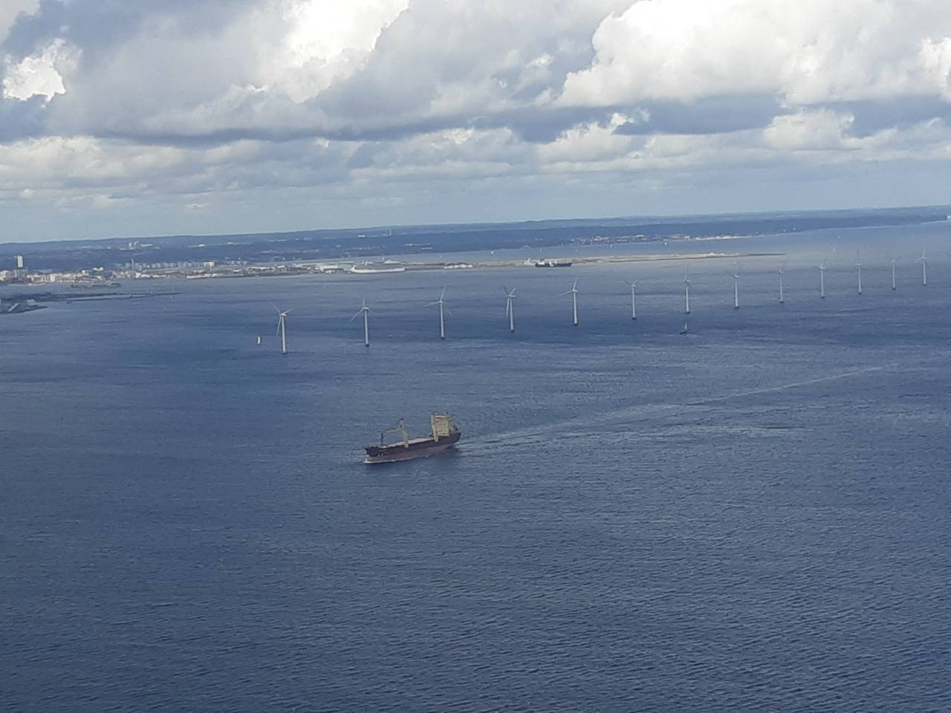
Thank you for your attention
The research for this paper has been conducted thanks to the financial support of the European Research Council under the European Union’s Horizon 2020 research and innovation programme (grant agreement No 639070 - SUSTAINABLEOCEAN).

